Slide 1
Curriculum Night 2018

Slide 2
My goals
By the end of this course, I want your child to:
Have a better grasp of how they learn
Be a better problem solver
See more connections, mathematical or other
Be prepared to successfully complete the calculus portion of the curriculum next year.

Slide 3
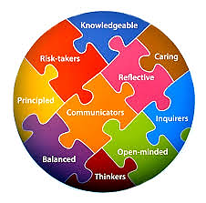
The IB Learner Profile

Slide 4
Topics for IB Math SL 1
Algebra
Functions and Equations
Circular Functions and Trigonometry
Vectors
Statistics and Probability

Slide 5
Students are familiar with most of the these topics, however they have not gone into the depth that IB expects. There are also symbols and notation not commonly used in the US that students will familiarize themselves with.

Slide 6
This year we will work on taking more ownership of our learning. The more we are able to encourage students to be active, involved, and aware of their own learning, the stronger an all-around student they’ll be. Think “Life-long learner”!!!!
There is a much larger focus on meta-cognition and analyzing a problem.
IB LOVES for students to make connections, between content and across contents.

Slide 7
Quick Facts About Ms. Blackert:
21st year in CMS
13th year at MPHS
I LOVE, LOVE, LOVE teaching high school math!!!!
msblackert.weebly.com
karen.blackert@cms.k12.nc.us

Slide 8
Classroom Donations?
The PTSO and IB PAC do such a fantastic job supporting teachers. Please continue to support these organizations! =)
Thank you!!

